Slide 1
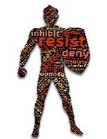
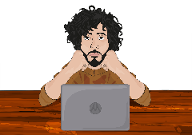
Where are people on their journey?
Resisting
“She only got the job because..”
“There needs to be a group for white men..”
”It’s gone to far..”
Passive
“D&I is not about me..”
“I don’t know how to help..”
”I am too busy to get involved in this..”
Reactive
“I have got a target..”
“This is the only way to succeed..”
”This is important to the boss..”
Allies
“I am actively mentoring under-representedgroups..”
“I champion them when they are not in the room..”
Inclusive Leader
“I challenge my own and others’ behaviour..”
“I make sure that inclusion is part of everything I do..”

Slide 2
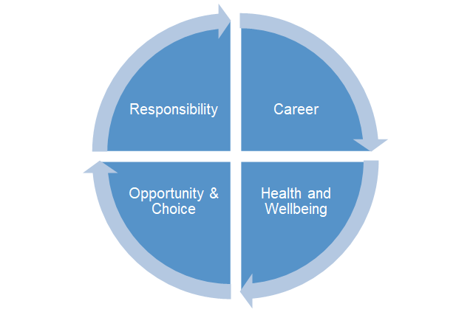
The personal case

Slide 3
The change journey
Version 2
A
D
U
C
E
Awareness
“I know about the lived experience of others..”
“I realise that there is relative advantage for some people..”
Desire
“I agree that this needs to be addressed..”
”I want to get involved to help but I don’t know how..”
Understanding
“I understand what actions I can take..”
“I can see how my behaviours might create issues.. ”
Capability
“I know how to take action..”
“I know how to change my behaviour to deliver a more inclusive workplace..”
Embedding
“I continue to prioritise my time to increase my knowledge..”
“I know how to deal with my and others mistakes..”

