Slide 1
WELCOME!

Slide 2
Who are we?
Non-profit organization committed to the professional development of women in the retirement plan industry
Network of more than 3,300 females across all career levels and segments of the retirement plan industry
Early-career, mid-career and senior-level
Recordkeepers, TPAs, DCIOs, broker-dealers, RIAs, ERISA attorneys, advisors and consultants.

Slide 3
Benefits of membership
Exclusive members-only networking events
Mentoring opportunities
Inspiring webinars on relevant professional development topics
Access to member directory
Notes:
Founded in 2009 by a group of industry leaders seeking to create a forum for women in the pension industry to network and cultivate professional and personal growth.
WiPN is an established 501(c)6 non-profit with a network of 1700+ women.
Membership represents all segments of the retirement industry including: early, mid- and senior level women across service providers (Recordkeepers, TPAs, DCIOs, ERISA attorneys, others) and financial advisors and consultants.
There is a long history of inequity and imbalance of women in the U.S. workforce: women earn 77 cents to a man’s dollar and there continues to be a lack of representation of women at Board of Director and C-Suite levels stalled at a meager 17%*.
Obstacles include a lack of mentorship and sponsorship both within their organizations and the industry.
Hard to find peers, mentors and advocates to support reaching goals.
Not as active in forming industry connections, touting accomplishments and asking for recommendations and referrals.
WiPN members have access to exclusive networking events, mentoring opportunities and interesting webinars.
Unique opportunities to connect with and learn from one another.

Slide 4
Our mission
Connect
In-person: Regional networking events and participation at national conferences Remotely: “Build Your Own Board of Directors to Create a 2020 Vision” Webinar Series
Share
Find a mentor -- or be one! Find a sounding board to talk through professional challenges
Promote
Enhance your visibility among accomplished women in the industry Increase your chances of being contacted about future opportunities

Slide 5
Our Sponsors

Slide 6
Our Sponsors

Slide 7
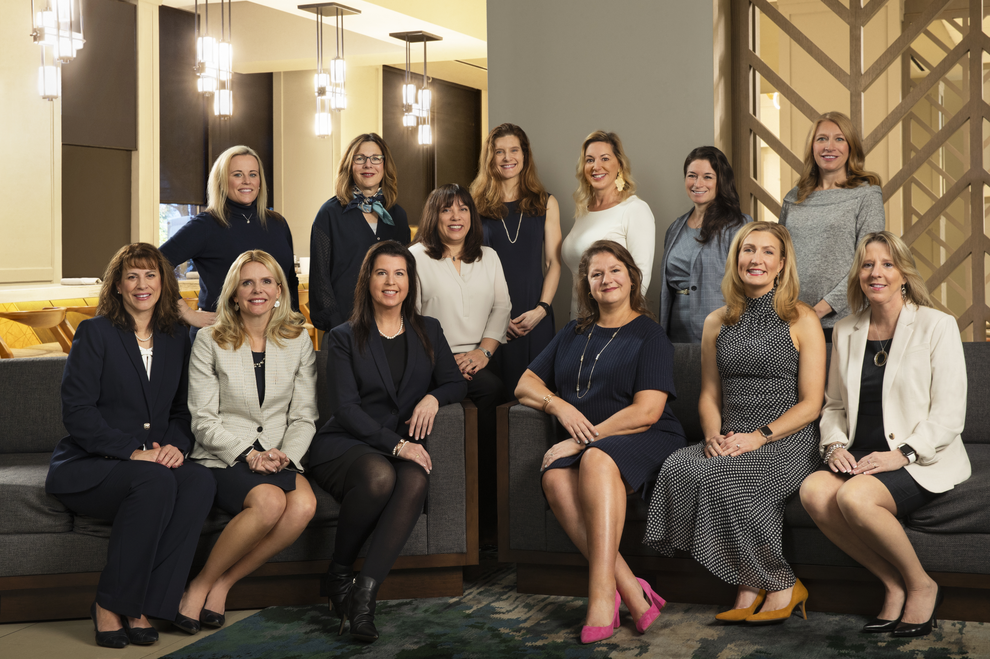
Front Row (L to R): Gail D’Amico, Jennifer Mulrooney, Brenda Rynski, Daniella Moiseyev, Cindy Kennedy, Pam Brooks . Back Row (L to R): Jillian White, Jean Martone, Melissa Cowan, Jennifer Norr, Lisa Smith, Val Ferrara, Lauren Hill

Slide 8
WiPN Board Members
President Daniella Moiseyev
President-Elect Jennifer Norr
Treasurer Lauren Hill
Secretary Jillian White
Events Lisa Smith
Marketing Jennifer Mulrooney
Membership Jean Martone
Programming Cindy Kennedy
Regional Chapters Val Ferrara
Special Projects Pam Brooks
Sponsorship Brenda Rynski
Past President Melissa Cowan

Slide 9
2020 Goals
Increase membership and engagement
Grow and support our regional chapters
Increase diversity in our organization and our industry
Develop content and programming to support our members personal and professional growth

Slide 10
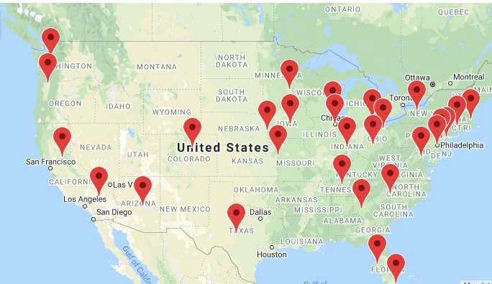
Regional Chapters
ARIZONA
ATLANTA
BAY AREA
BOSTON
CHICAGO
COLORADO
COLUMBUS
DETROIT
HARTFORD
INDIANAPOLIS
IOWA
KANSAS CITY
NASHVILLE
NEBRASKA / OMAHA METRO
NEW JERSEY
NEW YORK CITY
NORTHEAST OHIO
OREGON
PHILADELPHIA
SEATTLE
SOUTHEAST FLORIDA
SOUTHEAST WISCONSIN
SOUTHERN CALIFORNIA
TAMPA/ST. PETERSBURG
TEXAS
THE CAROLINAS
TWIN CITIES
WASHINGTON, DC
WESTERN NEW YORK

Slide 11
Calls To Action
Attend a Regional Meeting: Be a WiPN ambassador and bring a colleague
Introduce yourself to us at a national conference
Listen to our online webinar series
Join a WiPN committee – reach out to one of our Board of Directors directly
Get Social!
Follow us on LinkedIn
Join the members-only LinkedIn Group for networking and comments
Text WiPN to 31996 to join

